Slide 1
The Battle of Neighborhoods

Slide 2
Capstone Project - The Battle of Neighborhoods
Introduction
Introduction where you discuss the business problem and who would be interested in this project.
"Would you recommend a location in Hong Kong to open a new cinema?"
My boss, the stakeholder wants to open a new cinema as company's new business.
He explains that watching movie is a part of whole afternoon or night activities. Cinema should has many restaurants and shopping places nearby. Transportation is also an important factor. Customer can walk to cinema within 5 minutes from public transport facilities is perfect.
He wants me concentrated on selection of cinema location according to its nearby environment. Cinema facility and rental price is not my concern. He lists out his top 10 favorite cinemas in Hong Kong with rating.
I work with my teammates and select 5 possible locations to build the cinema. Which location should be suggested to the stakeholder?
Data
Data where you describe the data that will be used to solve the problem and the source of the data.
According to the question, following data are required.
1. Geographic coordinate of Hong Kong cinemas
I need to compare 5 possible locations with current cinemas in Hong Kong. Therefore, I need to find a list of Hong Kong cinema and cinemas' geographic coordinates. Luckily, I can find the list and coordinates from the website https://hkmovie6.com/cinema .

Slide 3
Capstone Project - The Battle of Neighborhoods
Methodology
Methodology section which represents the main component of the report where you discuss and describe any exploratory data analysis that you did, any inferential statistical testing that you performed, and what machine learnings were used and why.
With above data, I can use content-based recommendation technique to resolve the problem.
Combine with FourSquare API which provides how many venues in different category of Hong Kong cinemas, a matrix which captured characteristic of venues nearby cinema are built. Stakeholder's favorite list is the profile to combine with the matrix to become a weighted matrix of favorite cinema.
The weighted matrix can be applied on 5 target locations with venues information to generate a ranking result. The the top one on the ranking list can be recommended to the stakeholder.
Before building the matrix, I have to prepare the required data and apply some data analysis.
Data Cleansing and Preparation
Check the cinemas dataset contains any duplicated address

Slide 4
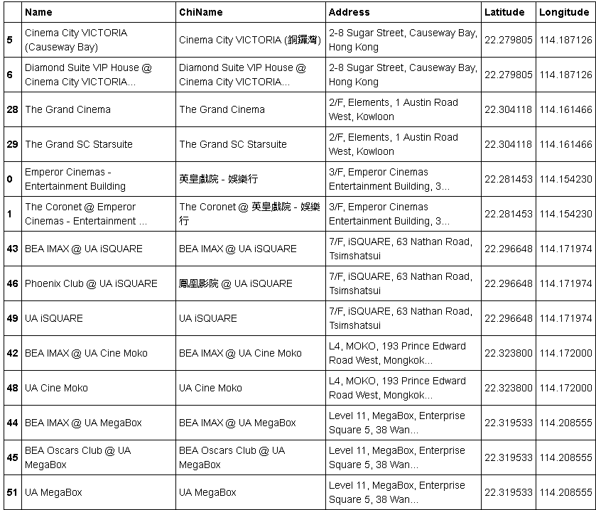
Check the cinemas dataset contains any duplicated address

Slide 5
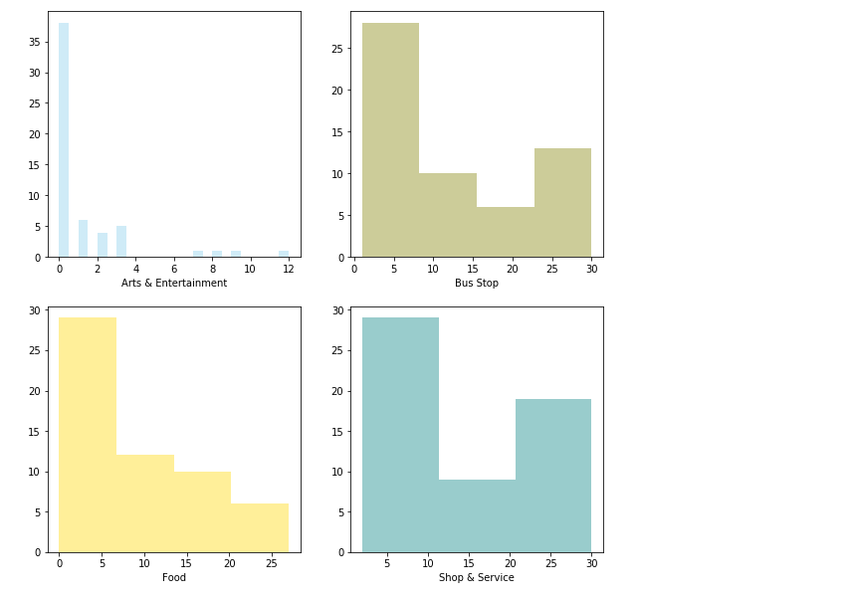
Plot the distribution of other variables

Slide 6
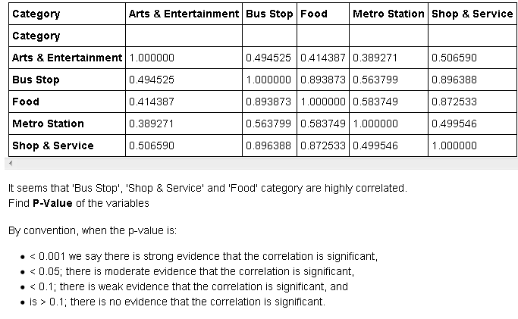
The distribution of other variables are quite similar. Now check their Pearson Correlation

Slide 7
Capstone Project Summary
Results
Results section where you discuss the results.
With the boss's profile and the complete list of cinemas and their venues count in hand, I am going to take the weighted average of every lcoation based on the profile and recommend the top location that most satisfy it.
Discussion
Discussion section where you discuss any observations you noted and any recommendations you can make based on the results.
Number of venues of 5 target locations are actually below the average
Conclusion
Conclusion section where you conclude the report.
The stakeholder's problem is resolved. Stakeholder wants to find the best place to build a new cinema in Hong Kong, and the factors of "best location" is based on the number of venues in eating, shopping, transportation category around the location. Stakeholder also provide his favorite list of cinema to further explain what the "best location" is. Content-based filtering machine learning technique is the most suitable method to resolve the problem. It combines stakeholder's preference and cinema profile to make the recommendation result.
The 5 target locations of new cinema may not be a good choices. As the weighting matrix is developed, I can quickly pick other locations and make the recommendation again.

